Slide 1
Exercises
Using Stack class/Objects

Slide 2
Exercise: Balanced Parentheses
Write a Python function that takes a string containing only parentheses (i.e., '(' and ')') as input and checks whether the parentheses in the string are balanced or not. Balanced parentheses means that each opening parenthesis must have a corresponding closing parenthesis in the correct order.
For example, the string "(())" contains balanced parentheses, but the string "(()))" does not.
Your task is to implement the is_balanced function using the Stack class to determine if the given string has balanced parentheses or not. The function should return True if the parentheses are balanced, and False otherwise.

Slide 3
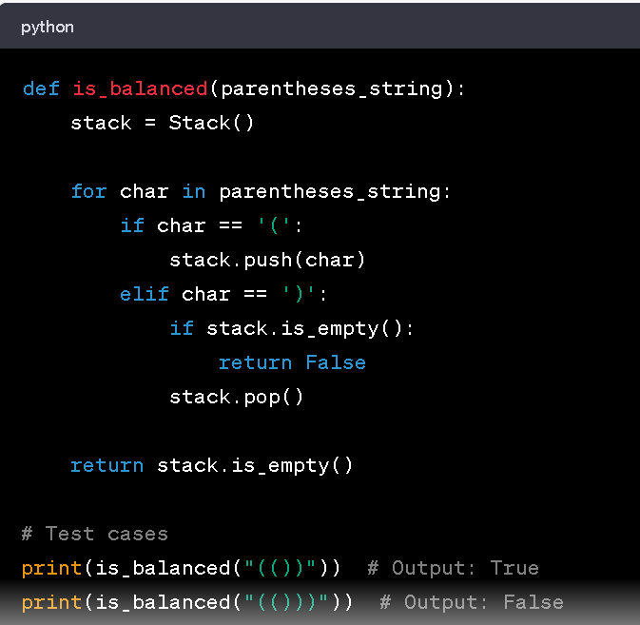
Sample solution balance Parenthesis

Slide 4
Exercise: Reversing a String
Write a Python function that takes a string as input and returns the string in reverse order. You should use the Stack class to implement the solution.

Slide 5
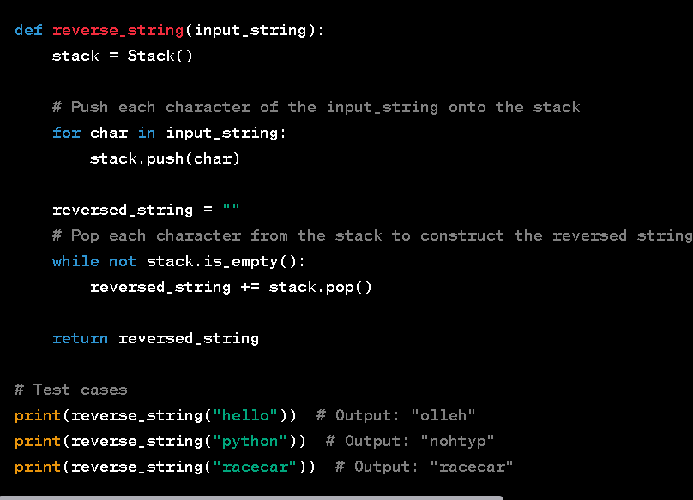
Sample solution Reverse words

Slide 6
Exercise: Managing a Guest List with a Stack
Imagine you are hosting an event and want to manage the guest list using a stack. Each guest will be represented as a "Person" object with attributes like name, age, and any other relevant information.
You need to implement a Python program that allows you to perform the following operations on the guest list using the Stack class:
add_guest(person): Adds a person to the guest list.
remove_guest(): Removes the last added person from the guest list (Last-In-First-Out).
get_guest_count(): Returns the total number of guests in the guest list.
view_guests(): Displays the names of all guests in the order they were added (top to bottom of the stack).

